Slide 1
Portfolio Project: Option 1 Jessica Ham
MIS542- Business Analytics
Colorado State University – Global Campus
Vincent Agboto March 8, 2020

Slide 2
Our Value Statement:
Our vision is to spearhead cutting edge trends through entrepreneurial design that will follow our customers through all stages of their lifetime.
Our employees are open-minded and look to constantly improve the experience for the customer and their coworkers.
Notes:
My employer in this scenario is a retail clothing store, looking to understand how to maximize the lifetime customer value of our existing customer base. Our goal is to understand what brings a customer back and how to make it happen as often as possible, for as long as possible.
The company’s value statement leans towards a company focused on lifetime purchasing, striving to value their customer and cater to them over time. What this statement highlights for me is a customer focused company that wants to create pertinent trends at all stages- beginning with teens and taking them through their first job, work wear, and straight into buying clothes for their children as they grow and become customers of their own. We are interested in creating stores that cater to all of these opportunities using open-minded employees that are willing to adapt our trends to stay relevant.

Slide 3
Lifetime Buyers
Fact:
“…satisfied customers return to trusted companies” (Damm & Monroy, 2013, para 8).
“A recent global study by Forbes Insights and marketing technology company Sailthru shows companies that make retention a priority significantly increases year-over-year market share compared with those that focused on acquiring new customers” (Sailthru, 2016, para 1).
Goal: “…identifying the most profitable customers, who will strengthen relationships in the long term…” (Estrella-Ramon et al, 2011, para 1).
Notes:
The facts listed above pertain to why our lifetime customers are so vital to business. It is commonly understood that it is more efficient to keep an existing customer than to source a new one. Established customers establish a strong sales base from which we can work to expand. Keeping these profitable customers has become the focus of marketing efforts, in order to “…implement relationship-marketing strategies with the most profitable one in order to retain these customers and increase purchases made by them” (Estrella-Ramon et al, 2011, para 1).
Our value statement is based in this concept. We are looking to have strong interactions with our customers that show them their value to us and keep them returning. Using the data set that was provided and this goal, to find our most profitable customers, we can start to develop an action plan that works to identify these customers where they are in our current base and understand them so that we can improve those relationships. We can also focus in on those customers who are not yet lifetime buyers but are on the cusp, and similarly understand them and work on a plan to convert them to lifetime buyers.

Slide 4
Lifetime Buyers
Business Questions pertinent to
Lifetime Customer Value:
What percentage of our current customers have purchased with us more than 5 times? What is the average amount of these purchases over time and how does it compare to the average of non-lifetime customers?
What is the difference in gross margins or markdowns between lifetime customers and non-lifetime customers?
Of customers we identify as lifetime buyers, what is the distribution of their spending by department?
What is the distribution of these lifetime buyers across designated lifestyle clusters?
Notes:
Part of this action plan is generating business questions that support our goal of maximizing the lifetime customer value. This means taking a deeper look at our particular customers and their purchasing habits. Reviewing the information we have on hand, we have not been tracking dates and individual sales, or at least this type of data is not accessible for this report. Instead we are looking at cluster types and lifetime visits as well as info on what types of items customers are buying. Based on this, we have formed a few business questions that support an initial attempt to understand how our customer buys over time.

Slide 5
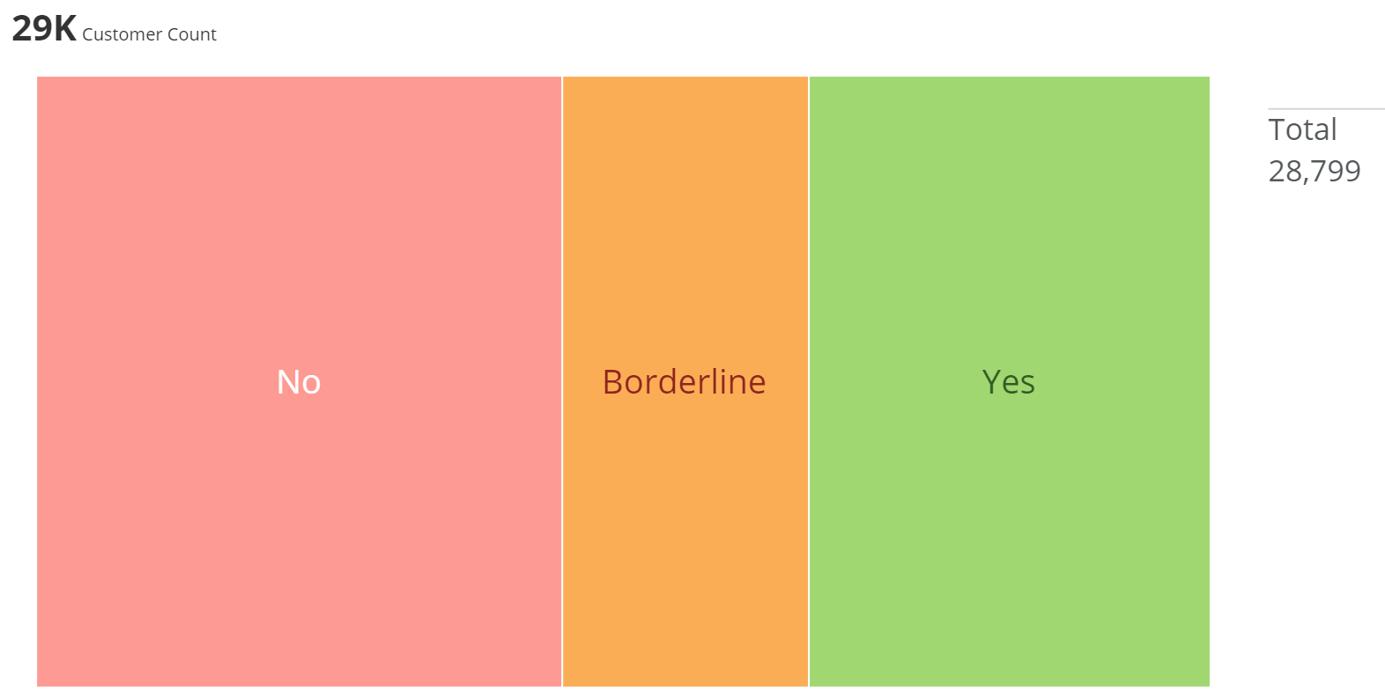
Business Question: What percentage of our current customers have purchased with us more than 5 times?
Notes:
Out of the 28,799 customers tracked within our data, the average number of visits to our store is 5. As we are just beginning to follow our customers, I chose to use this number as the decision point on who is a lifetime buyer. Shoppers that have visited us five or more times were categorized as Yes- lifetime buyers. Shoppers that have been to the store 3-4 times are possible to convert to lifetime and are classified as Borderline. Those shoppers who have been to our stores fewer than 3 times are in the No category as they are not lifetime customers and will be more difficult to convert. Based on these divisions, just shy of 10,000 have shopped in our stores 5 or more times (34.2% of our customers). 21% are in the borderline category and are possible lifetime customers. These customers would be important to send extra marketing to and encourage to return.

Slide 6
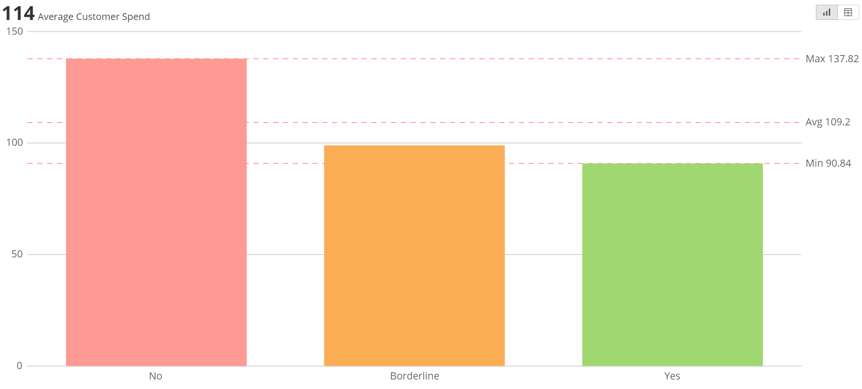
Business Question: What is the average amount of these purchases over time and how does it compare to the average of non-lifetime customers?
Notes:
What is interesting is when we look at the average purchasing habits of our lifetime customers. Their average spend is nearly $47/visit less than our one-off shopper! This statistic is concerning, as the hope is we gain more from the consistent shopper and their loyalty to our product. It is true that 5 shopping trips at $90 each is still more revenue per customer than the cumulative revenue from the other groups, but this is still a variance we should make an effort to reduce.

Slide 7
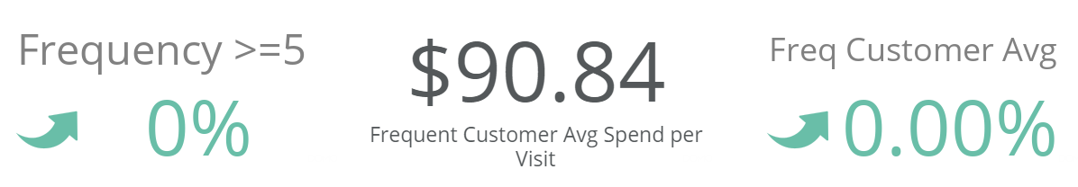
Business Question: What percentage of our current customers have purchased with us more than 5 times? What is the average amount of these purchases over time and how does it compare to the average of non-lifetime customers?
Notes:
For the purpose of consistent monitoring, it would be hard to see small improvements in the charts in the two previous slides. When we look at making a dashboard, a gauge can be used in place of certain graphics to quickly highlight our progress towards goals. If our goal is to increase the number of lifetime shoppers as well as increase their average spend, the gauges shown here are a means of benchmarking our progress over time. Each of the arrow graphics are linked to a prior number. As we are just starting out, we don’t really have a figure to compare to, but as we move forward, we can include a constant from the prior period that will hopefully show our decision makers consistent improvement over the prior period.

Slide 8
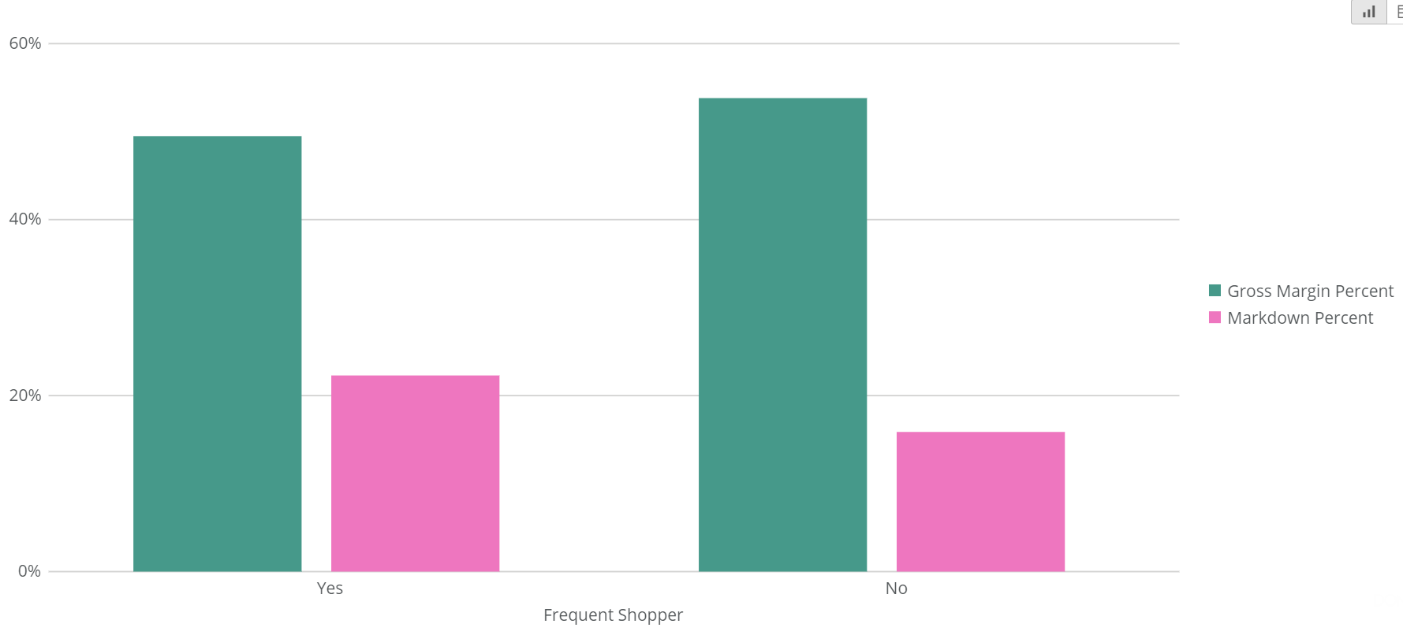
Business Question: What is the difference in gross margins or markdowns between lifetime customers and non-lifetime customers?
Notes:
When we look at the percent of purchases that have been bought on sale, we can see that our frequent shoppers actually shop sales more often than our non-frequent customers, 22% compared to 16% respectively. It would be important to work on bringing in those regular customers more often without a markdown, as, when we look at the gross margin percent, we can see that the result of the bargain shopping is a lower profit from our frequent customers. If we only looked at these figures, it would be hard to argue the value of a lifetime customer, as our one-off buyers are currently bringing in more profits! A 6% difference in profit margin is not something to ignore!

Slide 9
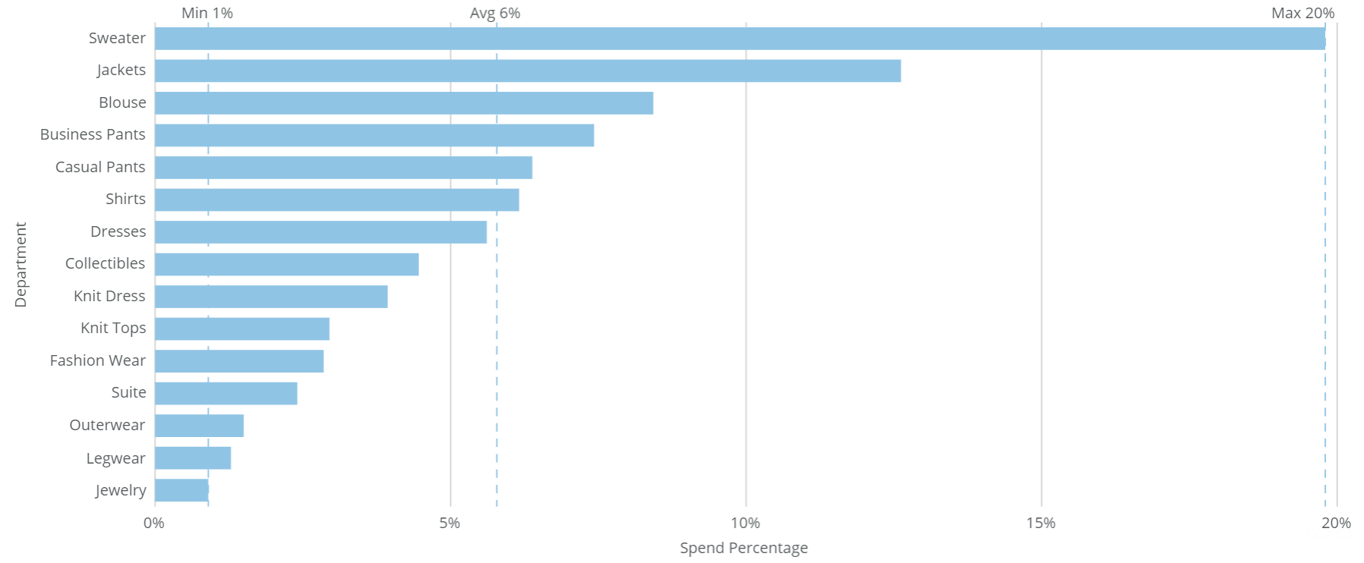
Business Question: Of customers we identify as lifetime buyers, what is the distribution of their spending by department?
Notes:
Another important thing to understand is what is our frequent shopper buying. This is very telling in that we can see what they come back for and what departments we perhaps need to improve. An average performing department captures 6% of sales from a customer. Top performers are sweaters, jackets, blouses and business pants. Some products we might focus marketing on would be the average performers such as casual pants, shirts and dresses. These items sell well already, but could become staples for our customer with work. Departments that are of concern are jewelry, legwear and outerwear. Keep in mind that if we are selling costume jewelry, the price point of these items and legwear will naturally make their sales lower in revenue than the other departments, so it is important again to not only look at these figures and make decisions. Outerwear is generally a seasonal product which could be a reason for its lower performance.

Slide 10
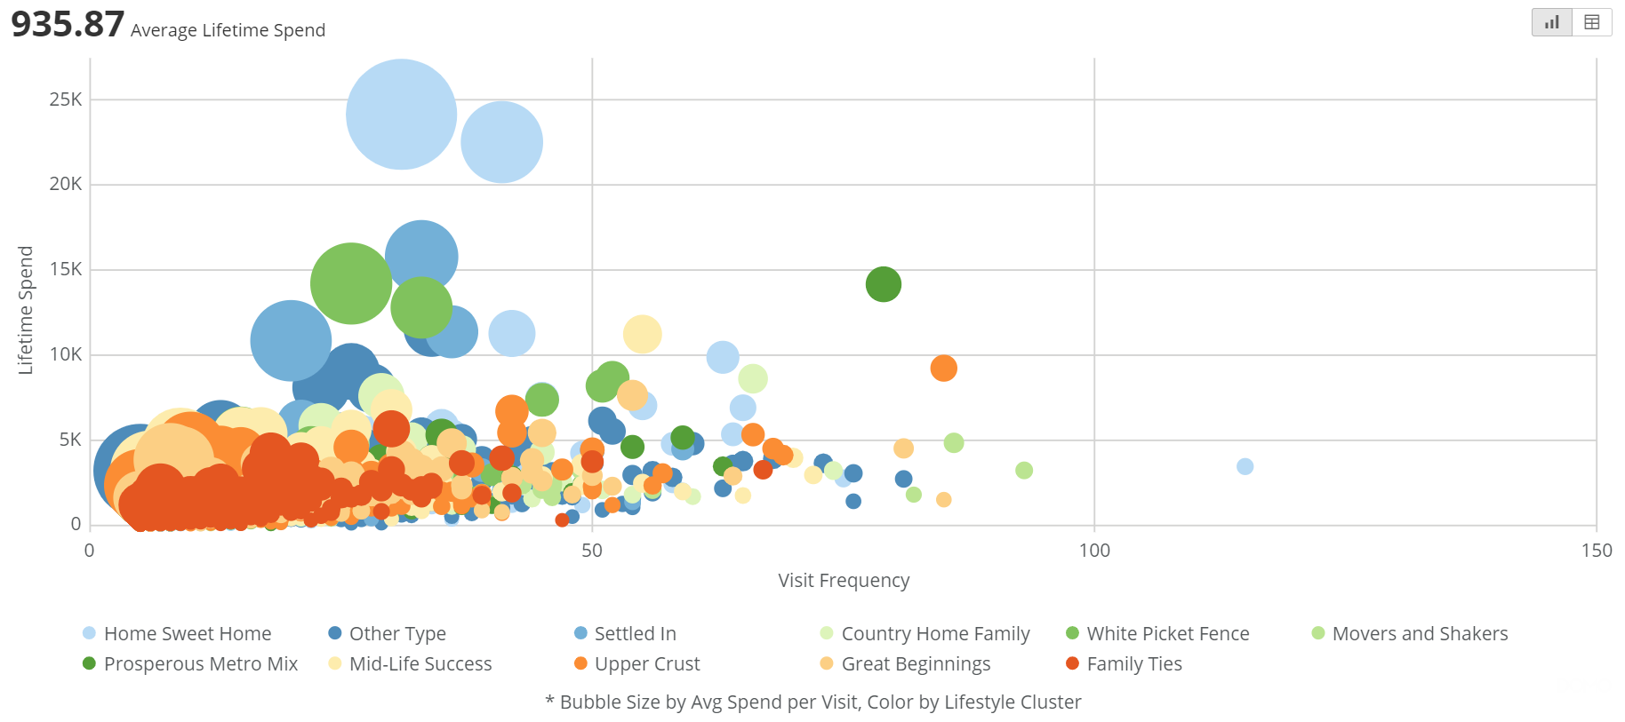
Business Question: What is the distribution of these lifetime buyers across designated lifestyle clusters?
Notes:
Our final business question had to do with understanding the lifestyles of our customers. It appears when we look at the cluster types of our frequent shoppers, much of our revenue is from families. Family Ties, Great Beginnings, Mid-Life Success, White Picket Fence, Country Home Family, Settled In and Home Sweet Home are all clusters that are categorized by having children in the home. These clusters for the most part all span the middle to upper class families.
For the visualization here I chose the bubble chart so that we could see the most possible information about our customers in one view. The x axis is the frequency of visits, the y axis is lifetime spending, and the bubble size represents the average spend per visit. One interesting insight is that customers that visit more than 50 times are neither our top lifetime spenders, nor is their average spend very large comparatively. It is possible a discount over a certain amount for long term customers could encourage improvements here. As many of the customers in this section are from Movers and Shakers, Great Beginnings and Upper Crust, it is possible that our younger customers are coming in for single items while our more established families come in less often for bigger trips.
The other section of interest for me are those customers with lifetime purchases over 10k. These are from the Settled In, Home Sweet Home and White Picket Fence groups, which further enforces our family appeal. The question would be how to get more of our customers to buy like these customers who are coming in more than 25 time and have very large average purchase rates.

Slide 11
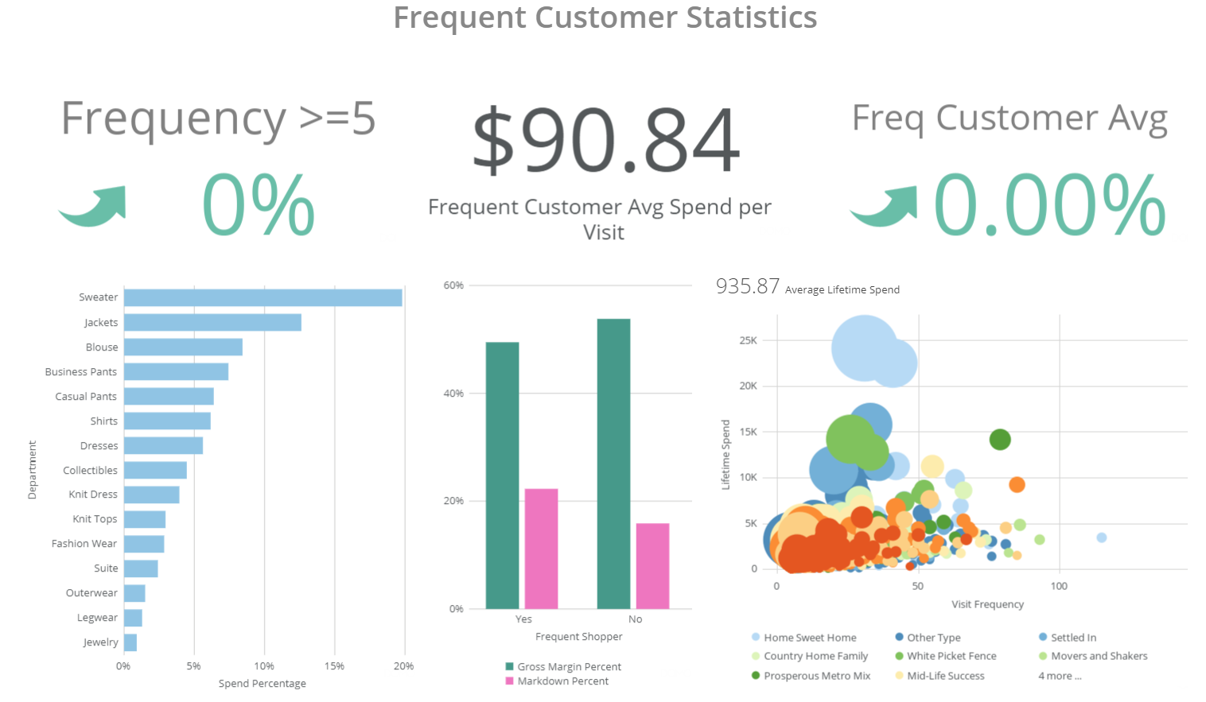
Dashboard Overview
Notes:
The previous slides are full of useful information, but it is inefficient to expect an executive decision maker to run each of these tables every time. To monitor progress, we create a dashboard. Dashboards allow for improved visibility with the time savings of having an updated, real time view at the decision makers disposal. This allows an executive to track how we are performing compared to expectations. “[I]n your dashboard, you can automatically show you goals from your business plan versus your actual, real time results” (Lavinsky, 2013, para 4).
The first three figures are exactly that. We are setting a goal to increase the number of Frequent shoppers and to increase the average spend per visit of these customers. The top bar is meant to be an instant check in for where we stand to these goals. Below are details of where these changes are coming from. We can see at a glance what department is improving in shares (bottom left), what consumer profiles are buying (bottom right), and what profit margins we are gaining compared to our non-frequent customers (bottom middle).

Slide 12

Roll-Out Planning
Raw Data
Understand our Customer
Dashboard Draft
Create Visible Insights
Launch Dash
Track Changes Against Goals
Live Data Feed
Connect to Real Time Information
Notes:
Our first step was to collect raw data, which we used for step 2, creating a draft of a dashboard. As we agree from today on any further changes, we can add those to the dash and then connect the updated visuals to our live data feed of the same information. This will allow the dash to be a real time read for decision makers on how we are performing against our goals. Finally we can roll the live dashboard out to the decision makers for use to track our current status against the goals we have established today.

Slide 13
References
Damm, Raphael and Monroy, Carlos Rodríguez (2011). A Review of the Customer Lifetime Value as a Customer Profitability Measure in the Context of Customer Relationship Management. Intangible Capital 7:2, Pp 261-279. Retrieved from: http://www.intangiblecapital.org/index.php/ic/article/view/227 .
Estrella-Ramón, A. M.; Sánchez-Pérez, M.; Swinnen, G.; VanHoof, K. (2013). A Marketing View of the Customer Value: Customer lifetime value and customer equity. South African Journal of Business Management 44:4, p47-64. Retrieved from: http://eds.a.ebscohost.com.csuglobal.idm.oclc.org/eds/detail/detail?vid=0&sid=b03c98e9-f4db-4902-aac9-880f3eca9010%40sdc-v-sessmgr01&bdata=JnNpdGU9ZWRzLWxpdmU%3d#AN=96352228&db=f5h
Lavinsky, Dave (2013). Executive Dashboards: What They are and Why Every Business needs One [Blog post]. Retrieved from: https://www.forbes.com/sites/davelavinsky/2013/09/06/executive-dashboards-what-they-are-why-every-business-needs-one/#3c57f48237d1.
Sailthru (2016). 7 Strategies for Turning Holiday Shoppers into Lifetime Customers. Retrieved from: https://www.businessinsider.com/sc/convert-holiday-shoppers-to-lifetime-buyers-2016-11.

